Slide 1
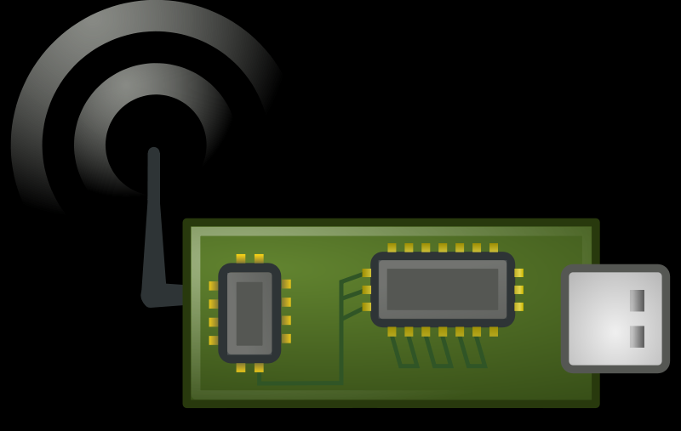
Sensors
Protocol
Broker
Database
Visualization
Telegraf
Influx
UofU Server
Web Browser
MQTT Publish
MQTT Subscribe
Google Web Server

Slide 2
Sensors
Protocol
Cloud Service
IoT to DB Broker
Database
Visualization
Google
Cloud Function
(Node.js)
Google
Big Query
Google Data Studios
IoT Core
MQTT Publish
MQTT Subscribe

Slide 3
Sensors
Protocol
Cloud Service
IoT to DB Broker
Database
Visualization
Cloud Function
(Node.js)
Cloud-based DB
Cloud-based Visualization
IoT Cloud Connection
MQTT Publish
MQTT Subscribe

Slide 4
aqandu
Cloud System
Current
Future
(1xGCP project)
Web App
(GCP)
Web App
w/Flask Server
Mobile App
Wearable
Web App
w/Flask Server
Flask Server
(GCP)
BigQuery DB
Firebase
User Credentials
Influx DB
(CADE)
BigQuery DB
Notes:
Create BigQuery instance in aqandu project
Web App pull data from BigQuery for visualization
Replicate Flask server API into the Web App
Login credentials WILL NOT be duplicated
Notes:
Maintain as is making incremental improvements in system as required
Continue work on API to support mobile app and wearable

